Slide 1






Platinum
Gold
Silver

Slide 2
Creative Solutions
w/ Microsoft 365
Charles Lakes
Notes:
Dark theme because developer.

Slide 3






Code Music Chocolate
Anime Pool Comics
Notes:
Things I like.
About me…
Blogger
SP since 2010
Graduated SPSU

Slide 4
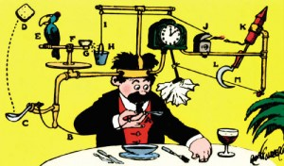
Rube Goldberg Machine
This Photo by Unknown Author is licensed under CC BY-SA
“is a chain reaction-type machine or contraption intentionally designed to perform a simple task in an indirect and overly complicated way. Usually, these machines consist of a series of simple unrelated devices; the action of each triggers the initiation of the next, eventually resulting in achieving a stated goal.” - Wikipedia

Slide 5
Employee Onboarding
Trigger
Action
Action
Action
Action
Action
Action
Notes:
Power Automate has micro-services.
“microservice architecture – a variant of the service-oriented architecture structural style – arranges an application as a collection of
loosely-coupled services.
In a microservices architecture, services are fine-grained and the protocols are
lightweight.”

Slide 6
Employee Onboarding
New Hire
Notify HR
Create Packet
Notify Marketing
Create Profile
Notify IT
Create Account
Notes:
Series of steps, each one following the next…

Slide 7
Microsoft 365
Exchange Online
SharePoint Online
Microsoft Forms
Microsoft Teams
Dynamics 365
Etc.
Notes:
Email
Content Management
Data Entry
Communication / Collaboration
Data Presentation
Task Automation
CRM (Customer Relationship Manager)

Slide 8
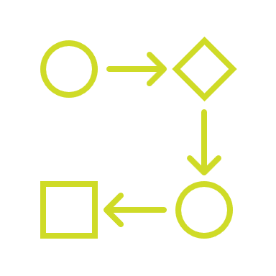
Power Automate
The plumbing for automated work processes and repetitive tasks…
Notes:
Stitches the solutions together…
But NOT limited to Microsoft solutions…

Slide 9
Power Users
Developers
Notes:
Somewhat of a middle ground:
+ Power users can do a lot.
+ Developers can do a lot more quickly.
Rapidly develop complex workflows.
Build your own custom actions.
Share connectors to these actions.
Fundamentals / Concepts…
Algorithms
Variables
Data Types
Functions
Loops

Slide 10
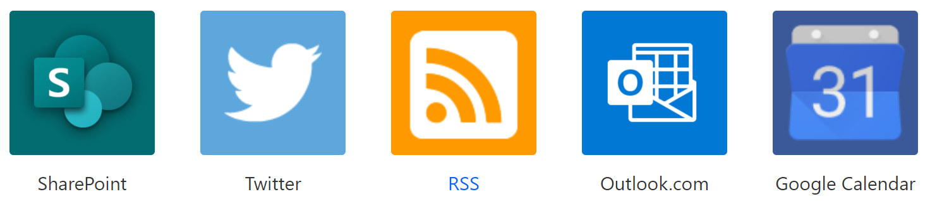
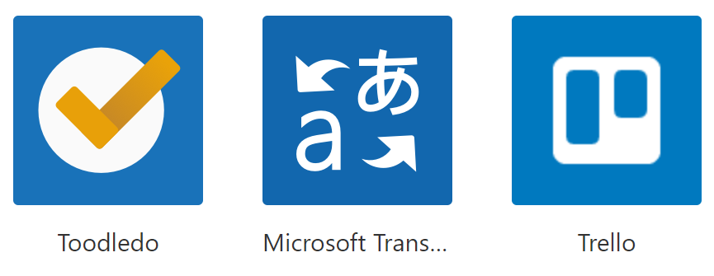
Standard Connectors:
Notes:
Asana
Box
Drop Box
GitHub
WordPress
YouTube

Slide 11
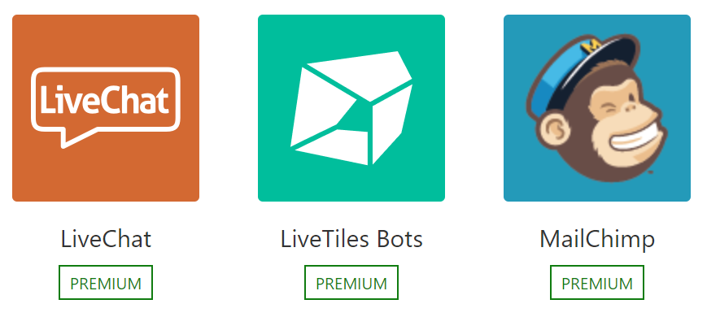

Premium Connectors:
Notes:
Eventbrite
Salesforce
ServiceNow
SQL Server
Survey Monkey

Slide 12
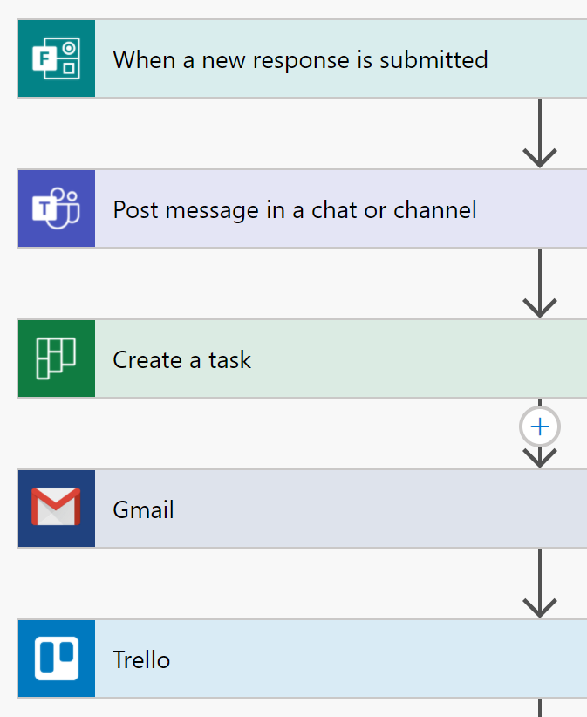
Sample #1
Notes:
Then a scheduled job could read their dept and automatically have their sites followed in SharePoint…

Slide 13

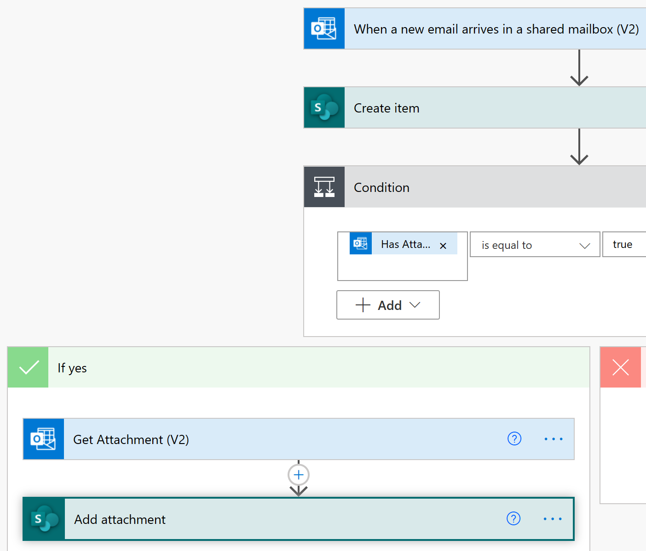
Sample #2
Notes:
Get attachments from dedicated mailbox for applicants.

Slide 14
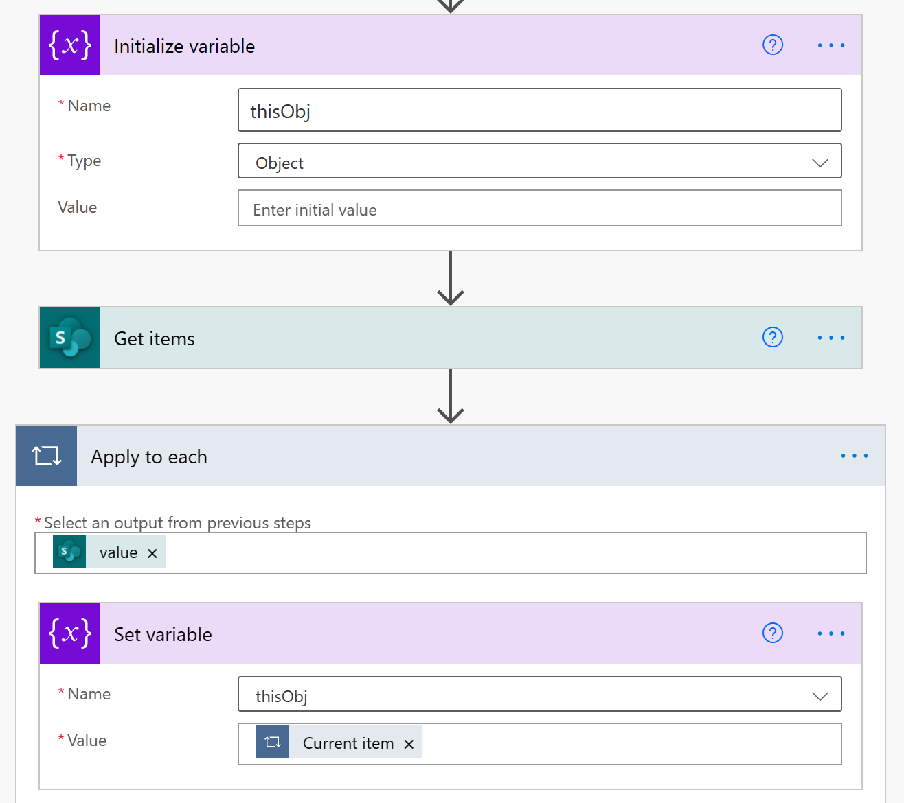
Sample #3
Notes:
Generate a series of tasks for new hire onboarding.
Example of initializing and setting variables.

Slide 15
Demo.Init();

Slide 16
Charles@TheIILakesGroup.com
Contact:

Slide 17
CharlesLakes.com
Blog:

Slide 18
Prego
Gracias
Merci

